Slide 1

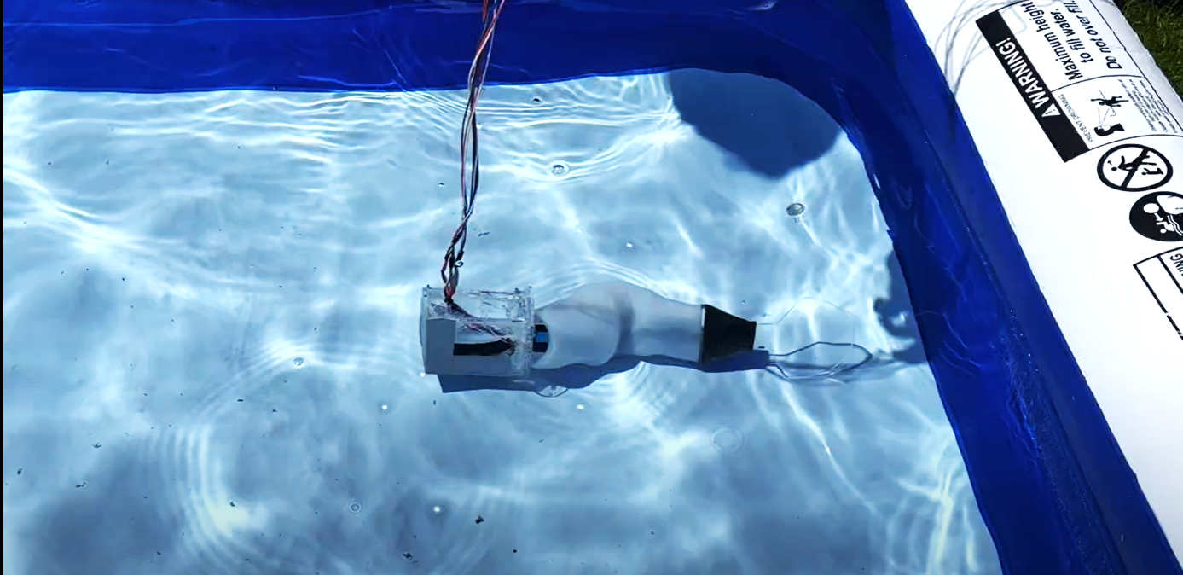
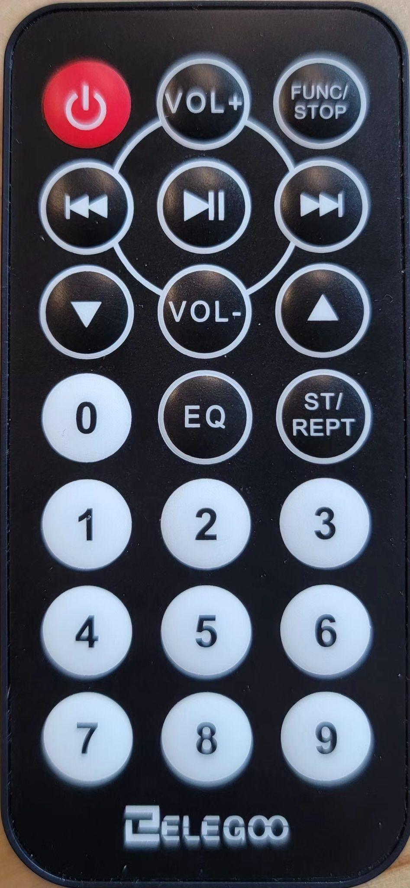
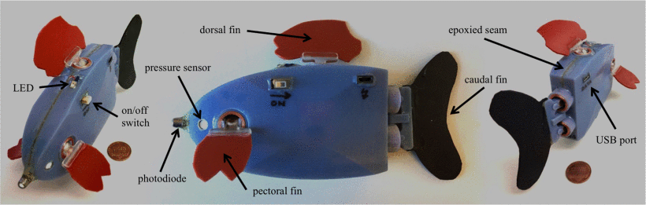
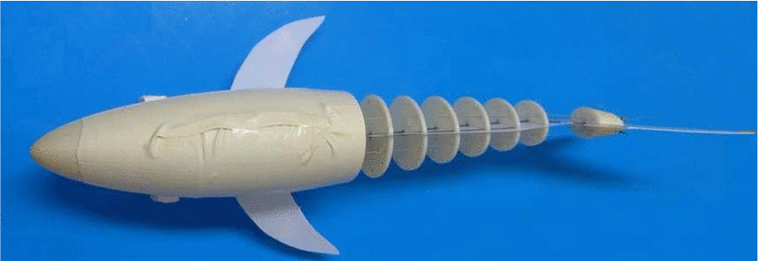
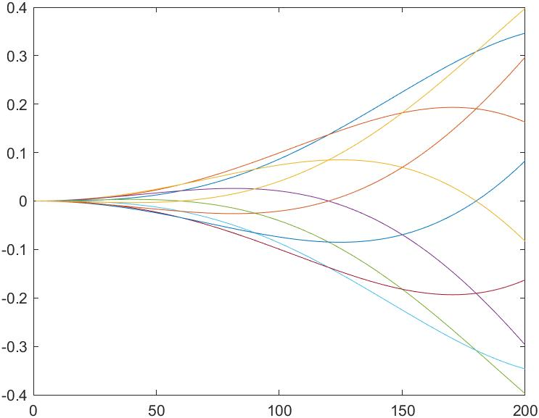
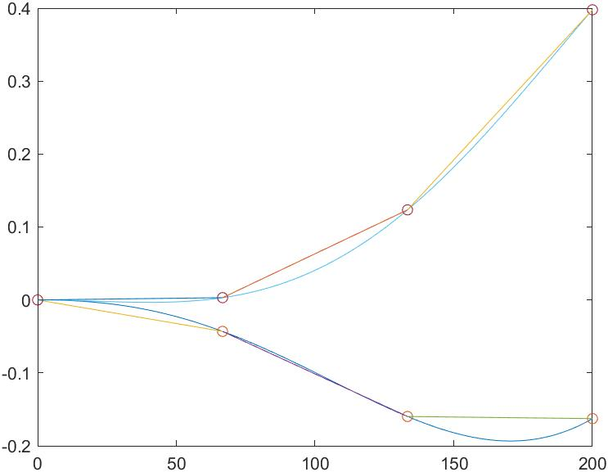
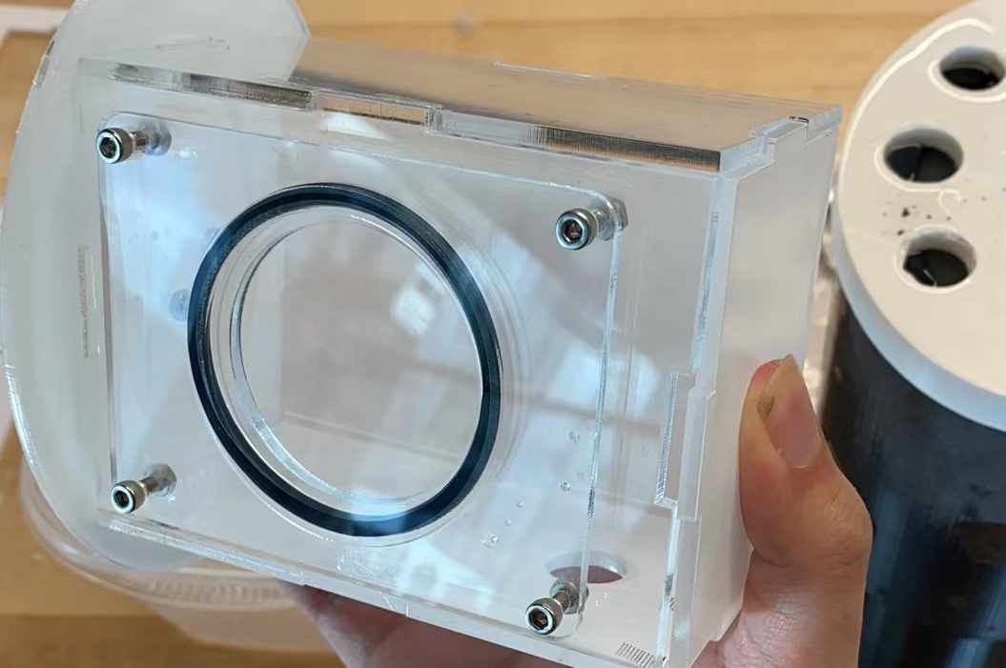
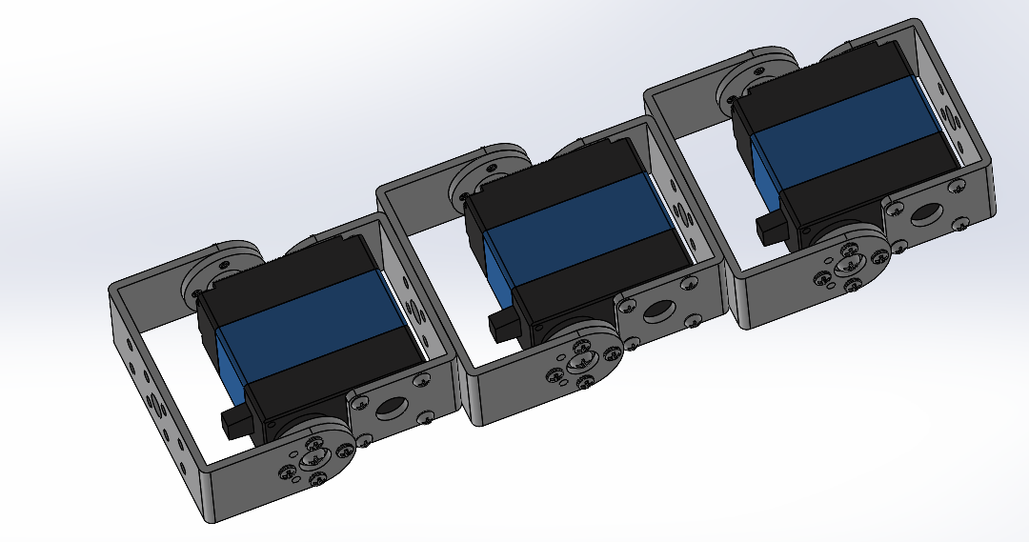
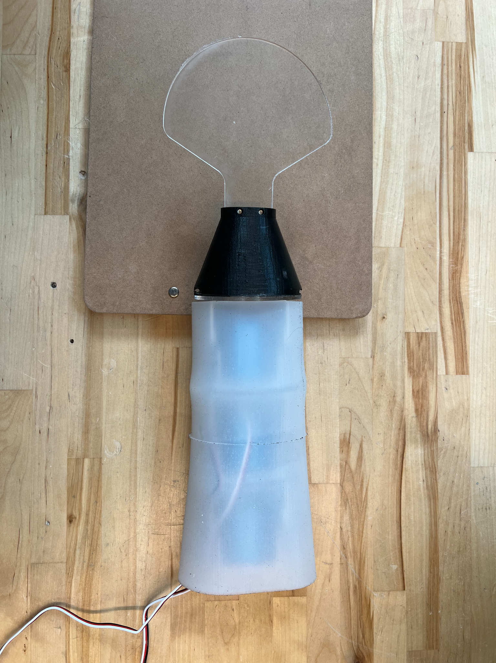
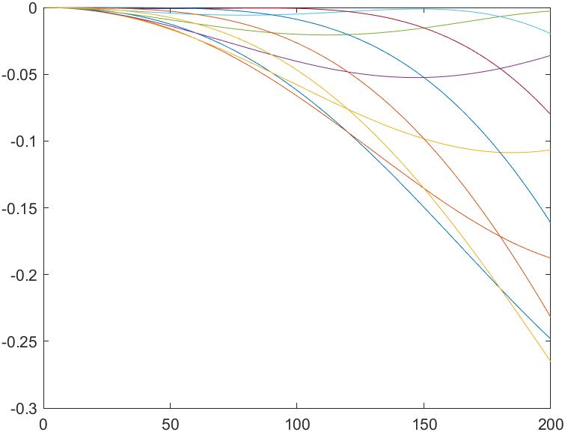
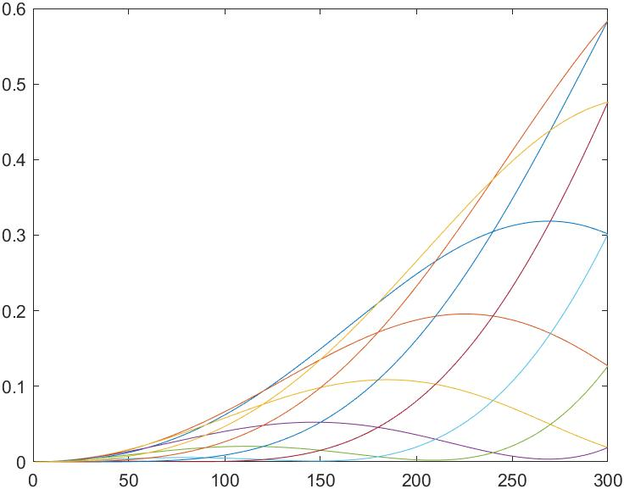
Mobility Study of Multi-Joint Driven Robot Fish
Lindy Cornwall, Xu Mo, Yibo Chen, Yuanqing Chen, Yufeng Ren
24775, Bioinspired Robot Design, Mechanical Engineering
Introduction
Method
Experimental Plan
Motivation
Fish are able to maneuver quickly and easily in water by using their long, flexible tail. Many robots have tried to mimic their movements, a few which are shown below. Our project aims to build on previous research on fish-like underwater robots by designing and building a robotic fish with a tail that uses three servo motors chained together, in order to analyze how different tail speeds and stiffnesses of the tail affect its mobility.
Previous Work
Remote Control Design
forward
close file and save it in the SD card
turn left/right
action combo A: go forward for 3 seconds and turning left immediately for the next 3 seconds.
stop
action combo B: go forward for 3 seconds and turning right immediately for the next 3 seconds.
optimal speed
speed level 1
disable servo 1 and make it locked at position 0
speed level 2
disable servo 1 and servo 2 and make them locked at position 0
Testing was done in an inflatable pool using 2 sets of variables
speed level 3
release all servo lockdown and recover them as default settings
Low Tail Frequency and Amplitude
High Tail Frequency and Amplitude
This robotic fish uses four motors to move.
speed level 4
1 Servo
2 Servos
3 Servos
Arduino Modules
Results
SD Card
DHT
Remote Communication
Observational results for speed levels (3 active servos)
Records gyroscopic data while testing
Senses the humidity to indicate any leaks
Speed Level | Forward Speed | Directional Stability | Turning Stability
1 | Nearly None | Nan | Nan
2 | Medium | Low | Low
3 | Fast | Low | Low
4 | Very Fast | Very Low | Cannot Turn
5 | Very Fast | Medium | Medium
Allows for external mode changes
This wire-driven robotic shark was developed for better maneuverability.
LED Indicator
Gyroscope
Servo
Method
Indicates the current state of the robot
Obtains acceleration and velocity data
Controls the servo motors to mimic fish tail motion
Fish Body Wave Reconstruction
The ideal fish body wave is sine-like as reconstructed in Fig. 1 and we simulated it with a three-end servo system as shown in Fig. 2.
Mechanical Design
Observational results for servo modes (5th speed mode)
# Servos Active | Forward Speed | Directional Stability | Turning Stability
3 | Fast | Very Low | Cannot Turn
2 | Medium | High | Medium
1 | No Movement | Nan | Nan
The head of the fish holds the sensors and arduinos. It is fully waterproof to allow the robot to be untethered.
Conclusions
Due to mass balance issues, the robot did not behave well enough to obtain useful quantitative data from the gyroscope. This data was taken from video observations of the robot performance tests. From these results, we have concluded that a higher tail frequency and amplitude along with more tail flexibility is optimal for better maneuverability.
Fig. 1
Fig. 2
The motion of the tail is controlled by 3 waterproof servos chained together. These can be enabled or disabled to simulate different stiffnesses
After we apply the skew coefficient and magnitude coefficient to the wave function, we can obtain turning wave function for fish body.
References/Acknowledgements
Special thanks for Prof. Vickie Webster-Wood and all the TAs.
Khiyavi, Omid Ahmadi, et al. "Design, Manufacturing and Motion Generation of a Shark Robot." 2018 6th RSI International Conference on Robotics and Mechatronics (IcRoM). IEEE, 2018.
Liang, JainHong, et al. "Experiment of robofish aided underwater archaeology." 2005 IEEE International Conference on Robotics and Biomimetics-ROBIO. IEEE, 2005.
Berlinger, Florian, et al. "Robust maneuverability of a miniature, low-cost underwater robot using multiple fin actuation." IEEE Robotics and Automation Letters 3.1 (2017): 140-147.
The tail of the fish surrounds the motors with a flexible silicone shell, with a 3D printed tail attachment on the last motor
Fig. 3 Fig. 4
Notes:
Shrink NSF logo, move refs/ackn down
Remove some bullet points from future work
Combine future work/conclusions – move box here
Methods + Results – switch section
Possibly crop well plate image(?)

